Slide 1

AUNT JEMIMA Pancake Mixes and Syrups
Presented By:
Arma, Avani, Aupala, Dhruv, Meesum, Sandeep

Slide 2

Industry Snapshot
CATEGORY: Consumer Packaged Goods
SUBCATEGORY: Pancake Mixes & Syrup
MARKET: Food & Beverage
LAUNCH DATE: 1888 and 1889 by the Pearl Milling Company.
MARKET SIZE (US, 2024):
Pancake Mixes: ~574.8 million
Syrups (including Pancake & Table Syrups): ~$ 12.9 billion
MAJOR COMPETITORS: BETTY CROCKER, KRUSTEAZ, HUNGRY JACK, and KODIAK CAKES

Slide 3
Market Overview
Consumer Profile:
Marketing Strategies Adopted:
Price Sensitivity & Value Bundling: Promotions and multi-pack offerings to appeal to cost-conscious consumers.
Brand Trust & Legacy: Leveraging long-standing brand reputation to maintain customer loyalty.
Nutritional Shifts: Adapting to consumer preferences for gluten-free, whole grain, and low-sugar options.
Clean-Label & Sustainability Claims: Highlighting natural ingredients and environmentally friendly practices to align with health-conscious and eco-aware buyers.
Segment | Key Traits
Families with Kids | They will be more loyal to traditional brands and value size packs
Millennials/Gen Z | Health conscious thus prefer clean labels like vegan/gluten-free
Budget-conscious Shoppers | Lean towards labels with promotion and value for money
Occasional cooks | Seek for versatility and easy to cook products

Slide 4
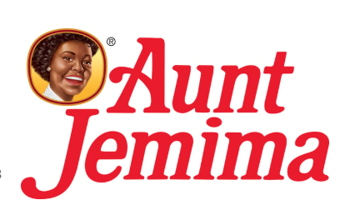
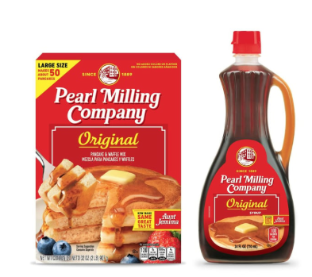
What is the Event?
On June 17, 2020, Quaker Oats, a subsidiary of PepsiCo, announced that it would be retiring the Aunt Jemima brand, which had long been criticized for its origins rooted in racial stereotypes.
This marked a significant shift for the brand, which had been used for over 130 years.
In early 2021, it was relaunched under the new name "Pearl Milling Company."
However, the June 17, 2020, announcement serves as the key event date for evaluating changes in consumer behavior and sales performance surrounding the rebranding.

Slide 5
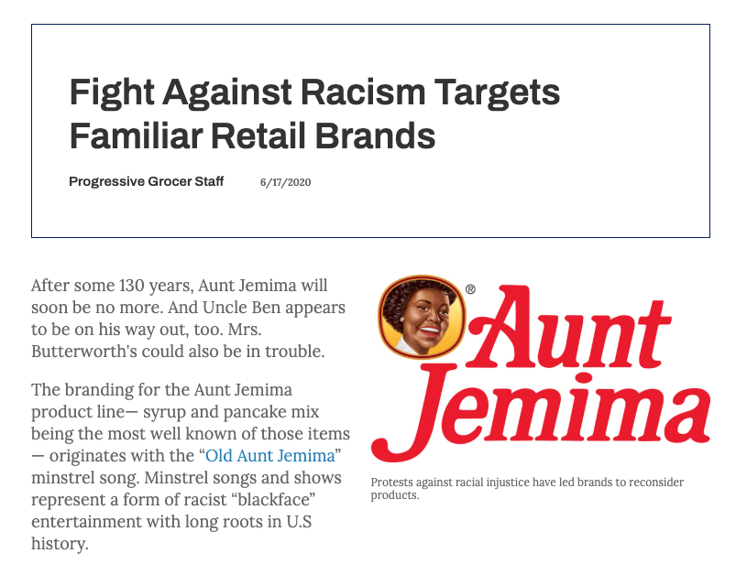
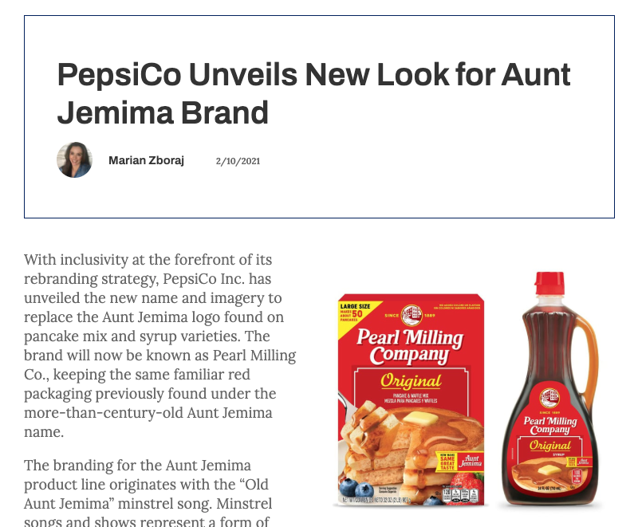
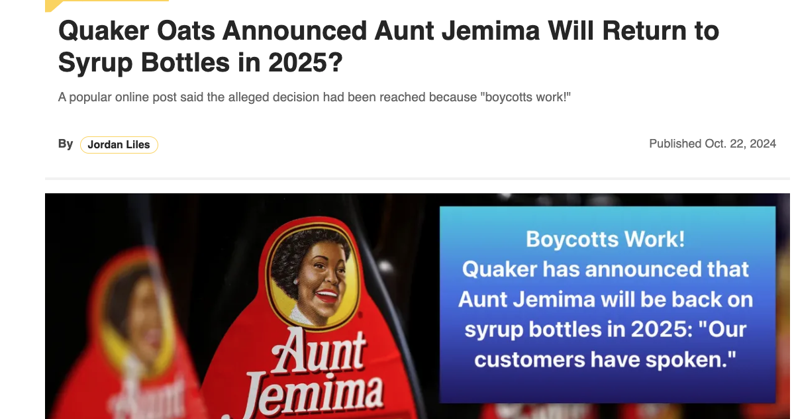
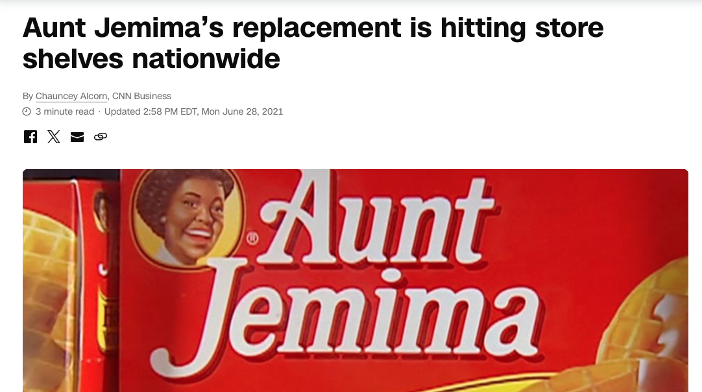
News Reports & Tweets
This article was published on June 17 2020
This article was published on October 2024
“Frustration about the misplaced priorities of rebranding.”
“Celebrates the rebrand, criticizing the outdated imagery.”
These articles were published on June 2021

Slide 6
Difference-in-Difference Analysis
Treatment Group: AUNT JEMIMA — Includes all observations related to the Aunt Jemima brand
Control Group: Betty Crocker, Krusteaz, Hungry Jack, Kodiak Cakes
Event Date: June 17th, 2020, This marks the official announcement that Aunt Jemima would remove the image from its packaging.
Post-Event Variable: A binary indicator where observations dated after June 17th, 2020, are marked as 1 (post-event) and those before as 0 (pre-event).
Treat Variable: A binary indicator equal to 1 for all data corresponding to Aunt Jemima (treatment group), and 0 for all data from the control brands.

Slide 7
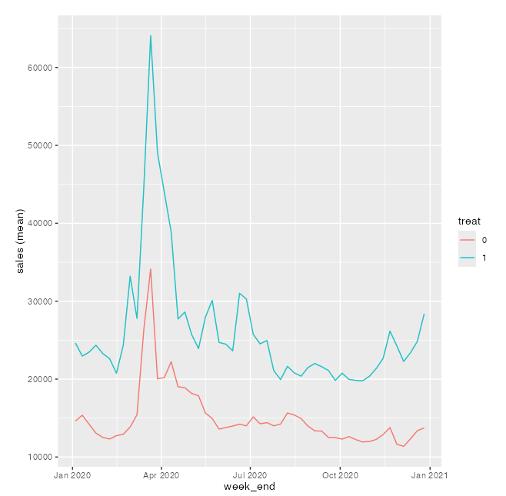
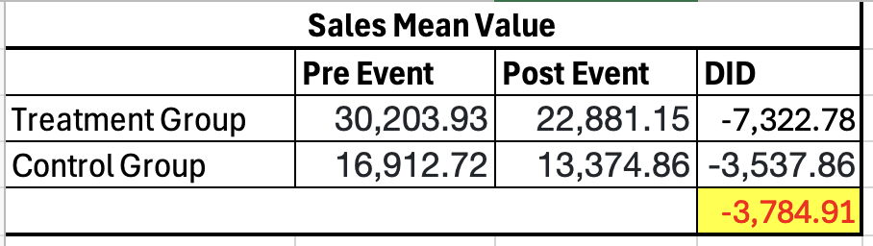
Validation of Difference-in-Difference Analysis
Parallel Trend
DiD Estimation
Based on the Difference-in-Differences (DiD) analysis, we found that after the event on June 17, 2020, the treatment group (Aunt Jemima) experienced a decrease in average sales of approximately 3,784.91 units relative to the control group.

Slide 8
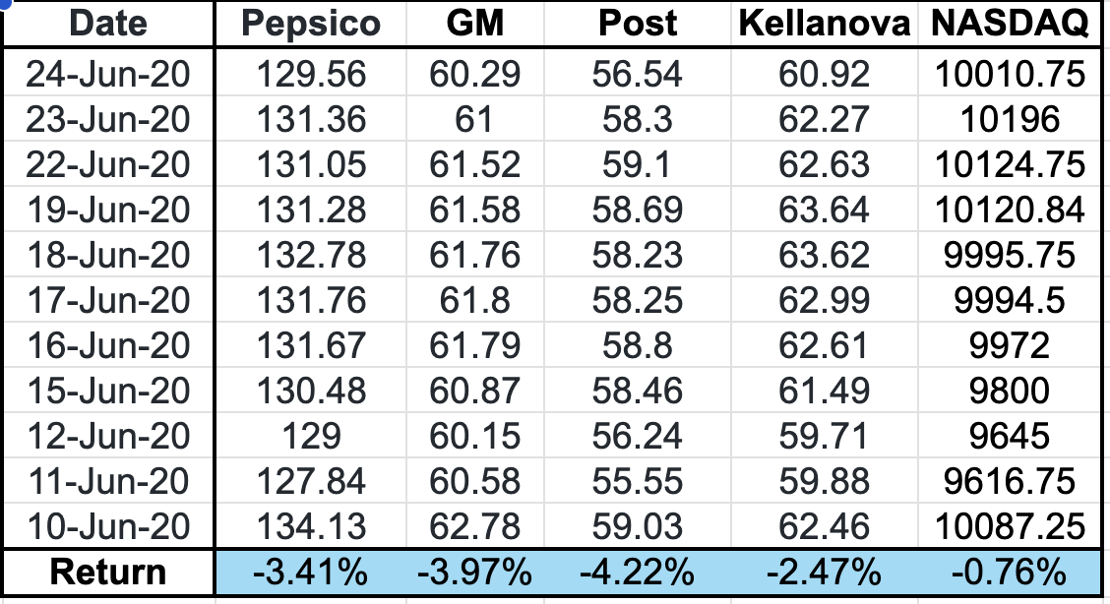
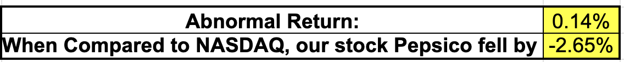
Stock Performance Analysis
Return Calculation
PepsiCo fell 3.41% during the Aunt Jemima logo retirement window (June 10–24, 2020)
Abnormal return: +0.14%, showing slightly Better-than-expected performance.
Underperformed the NASDAQ by 2.65%, indicating an event-driven reaction.
Peers dropped more sharply — General Mills (-3.97%) and Post (-4.22%).
Kellanova's smaller drop (-2.47%) reflects a milder investor response.
PepsiCo's decline was moderate compared to sector peers, suggesting limited long-term concern.
Abnormal Return

Slide 9
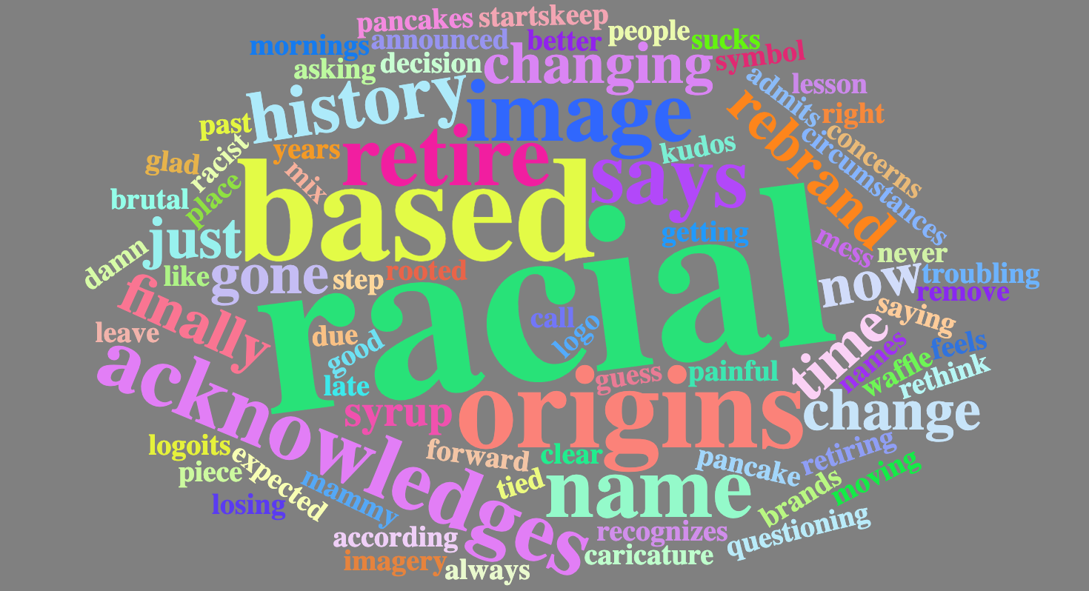
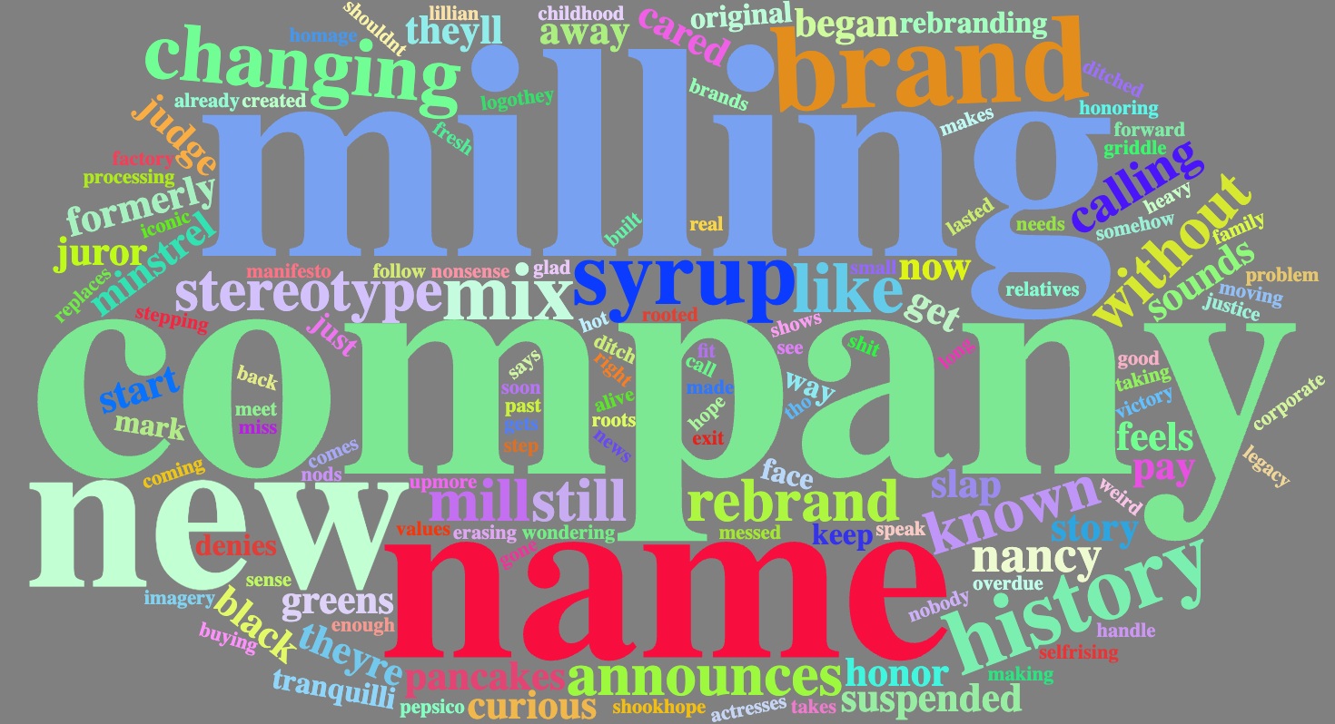
Sentiment and Word Analysis
World Cloud on the Event Day
World Cloud after the Event Day
Notes:
Left: Word Cloud on the Event Day
Prominent words: “racial,” “based,” “origins,” “retire,” “acknowledge”
Interpretation:
Indicates intense discourse around race, identity, and historical context.
Words like “retire” and “acknowledge” suggest the public was reacting to a decision or announcement tied to social justice.
Suggests the event was polarizing and framed around cultural reckoning.
Prominent words: “milling,” “company,” “name,” “brand,” “new”
Interpretation:
The conversation shifted from socio-cultural issues to corporate branding and operational changes.
Focus moved to what the company is doing next—e.g., rebranding, new name, or product changes.
Reflects how media and public sentiment evolve from critique to adaptation and acceptance.

Slide 10
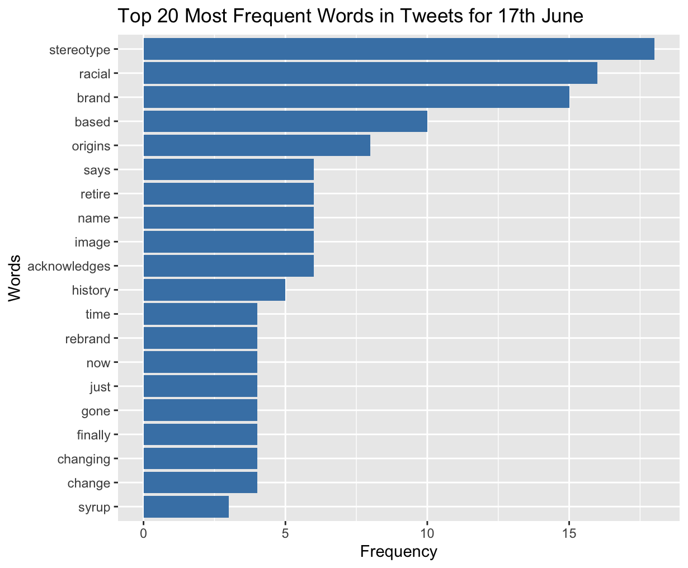
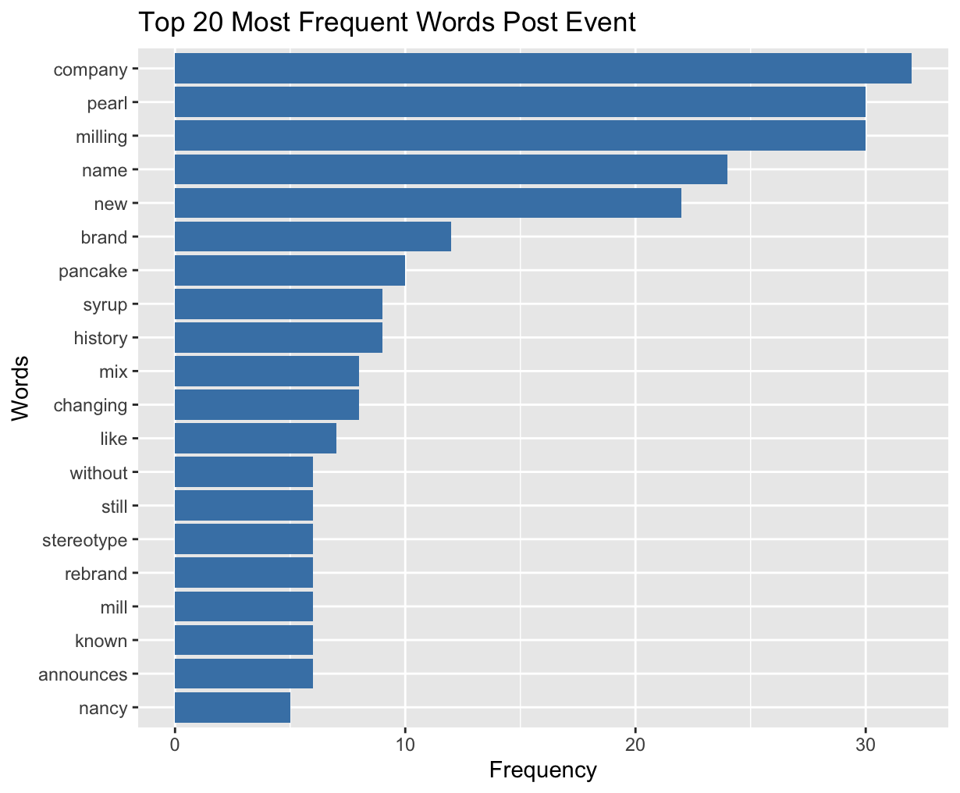
Top 20 Frequent Words in Tweets
On the event day, commonly used words such as “racial” and “stereotype” reflected the public's focus on the social and cultural implications of the rebranding.
In contrast, post-event discussions prominently featured terms like “Pearl,” “Milling,” and “Company,” indicating a shift in attention toward the brand’s new identity and consumer adaptation to the name change.

Slide 11
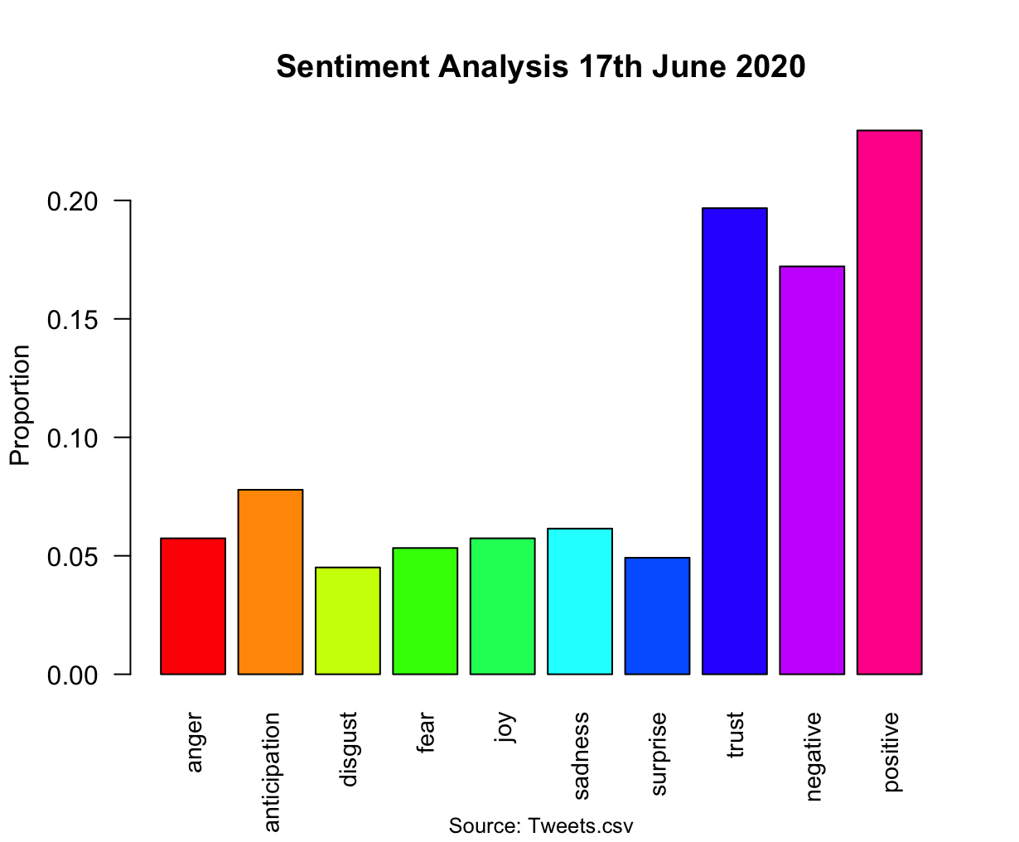
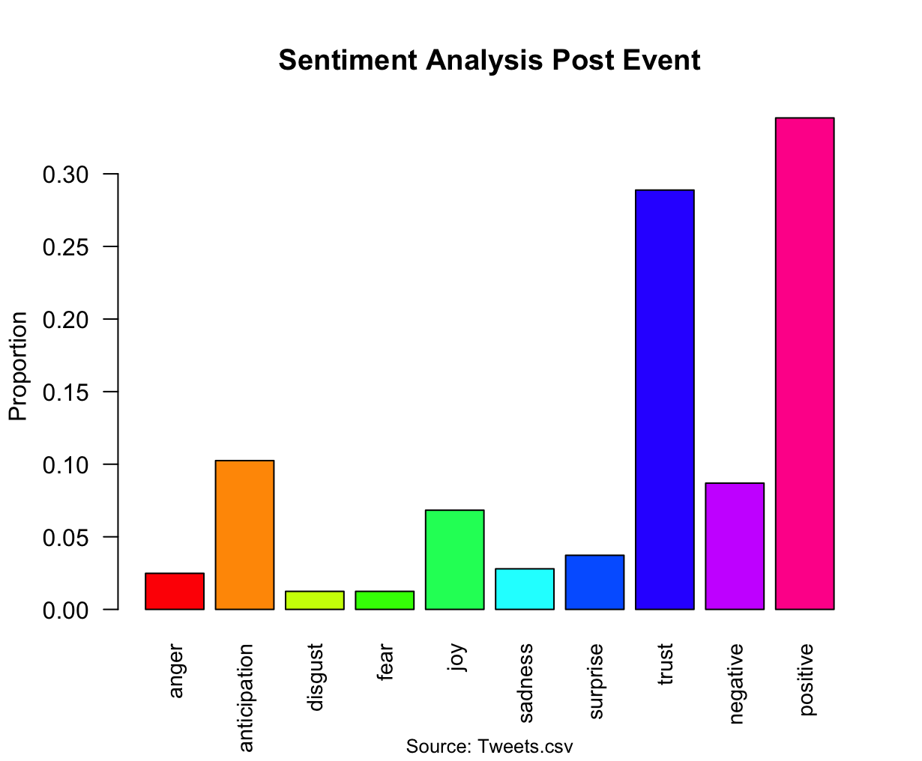
Sentiment Analysis
On the event day, negative sentiments such as anger, fear, and anticipation were observed at significantly higher levels, reflecting emotional public reactions to the rebranding announcement.
In the post-event period, the proportion of these sentiments decreased, suggesting that public response gradually stabilized as consumers began to adjust to the change.

Slide 12
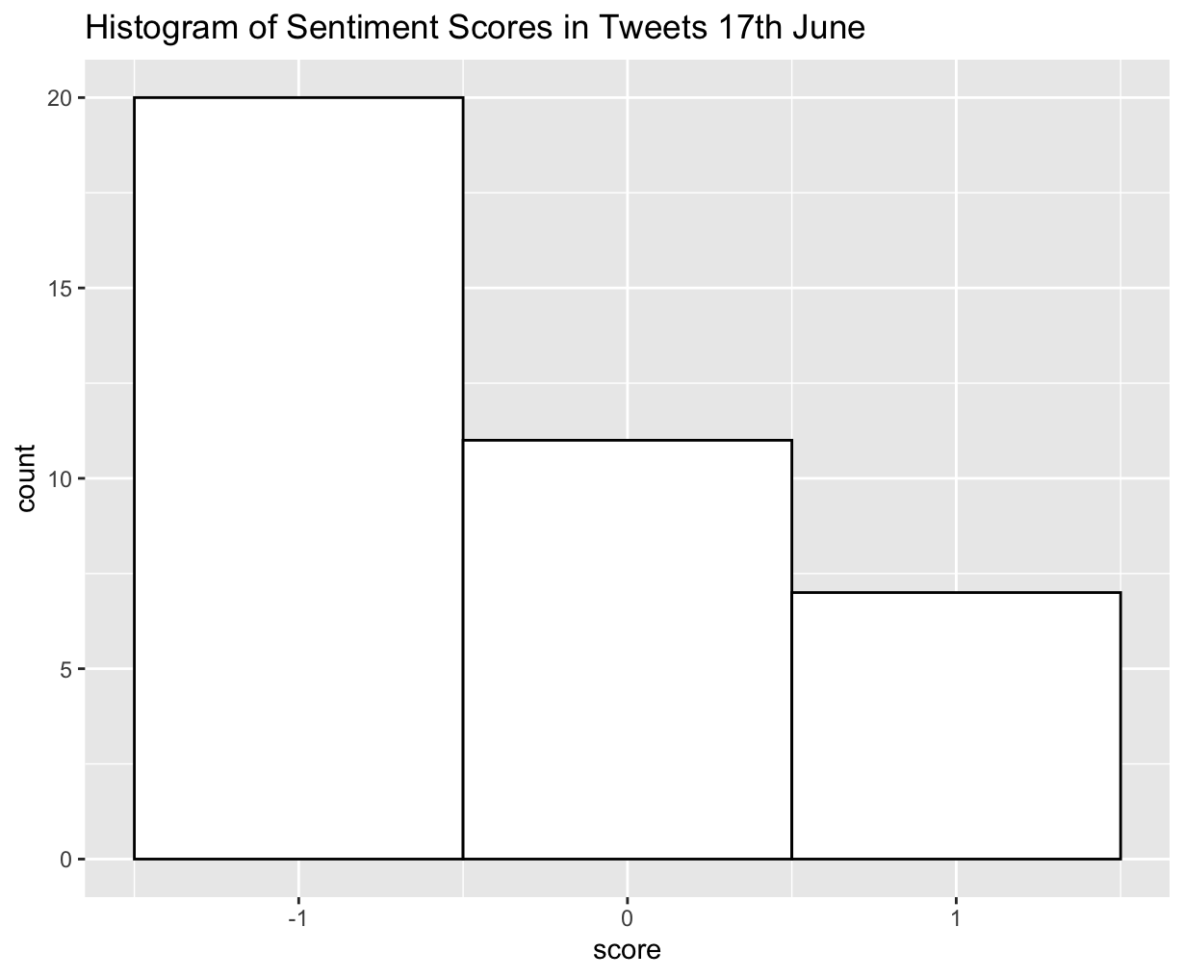
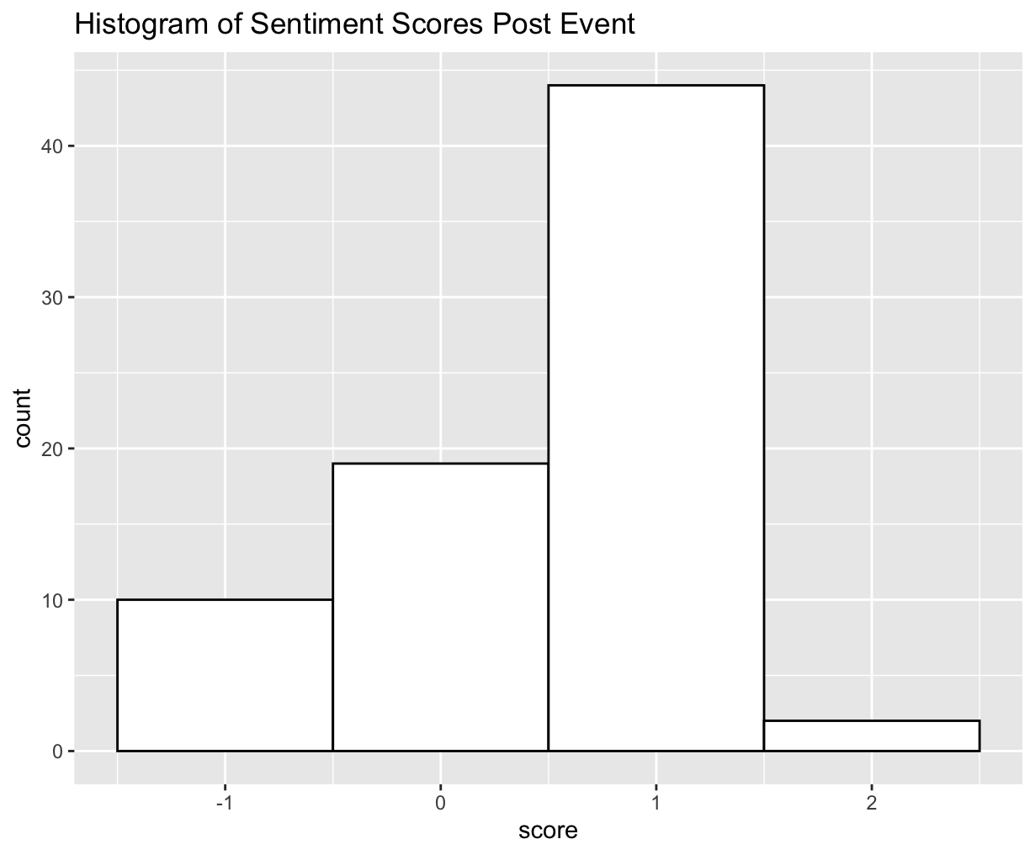
Sentiment Scores
On the event day, we see a score of ‘1’; however, post-event, the score reaches +1.

Slide 13
Key Challenges in the Industry
Rebranding & Brand Equity Risk: Brand transitions (e.g., Aunt Jemima → Pearl Milling) can impact customer loyalty and recognition.
Health Awareness: Rising demand for reduced-sugar, high-protein, and clean-label options challenges traditional product formulations.
Supply Chain Volatility: Price fluctuations in key ingredients like wheat, corn syrup, and maple syrup affect cost stability.
Sustainability Expectations: Increasing consumer demand for recyclable packaging and ethically sourced ingredients.

Slide 14




Conclusion on the Event Study
Our Difference-in-Differences (DiD) analysis indicates a decline in sales following the rebranding announcement, suggesting a negative consumer response to the event.
While the stock market reflected a slight dip in PepsiCo’s stock price around the event date, it is difficult to isolate the impact specifically tied to the Aunt Jemima brand, given the broader scope of PepsiCo’s portfolio.
Twitter sentiment analysis revealed a noticeable shift in public response before and after the announcement, highlighting changes in consumer perception and engagement on social media.
Overall, while the rebranding aligned with broader social justice movements, our findings suggest short-term reputational and financial trade-offs that are important for companies to consider when making similar branding decisions in the future.

